Slide 1


AIS Spoofing
By Joey Simone & R. Ben Voth
Notes:
Significance of Topic

Slide 2

What is AIS Spoofing?
Dissemination of false information over AIS
Used to describe intentional manipulation of vessel characteristics including;
Identity
Position
Course and Speed
Navigational status
(Courtnell, 2023)
Notes:
"The manipulation of a ship's Automatic Identification System (AIS) to disseminate false information regarding a vessel's actual location" (Courtnell). Data can be altered or entirely fabricated

Slide 3
How do vessels Spoof?
Identity theft/laundering: vessels steal the identity of another vessel, and not transmit their true identity. [1]
MMSI manipulation: when ships tamper with the MMSI number programed into and broadcasted from there AIS [3]
Dual transmission: vessel transmits data from multiple AIS transponders providing ambiguity to the vessel’s true identity and location. [4]
Location tampering: GPS locations/transmitted AIS routes are changed to display fabricated data. [2]
[1](Sasson, 2021)
[2] (Androjna & Perkovič, 2021, p 363)
[3] (Goudosis & Katsikas, 2020, p 288)
[4](Kelly, 2022, p 2).

Slide 4
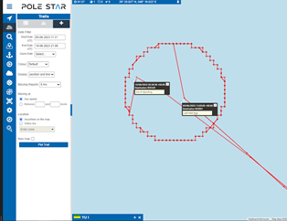
How to identify Spoofing?
Spoofed navigational tracks can be identified visually:
1. Long Term Anchor
2. Circle
3. Slow Roll
4. Pre-programmed route
(Sasson, 2021)
(Courtnell, 2023)
Notes:
Long term anchor: When vessel's transmitted data depicts it in one location (over an extended period of time)
Circle: Typically used when vessels load cargo. Vessel's AIS data shows vessel transmitting in a circle.
Slow Roll: "a vessel mimics movement, but at suspiciously sluggish speeds, with no economic rationale" (Courtnell).
Pre Programmed Route: when a vessel is meticulously programmed to follow plausible routes. This involves either replicating or obtaining historical AIS data to accurately simulate the vessel's course or engaging in thoughtful planning to create the impression of a legitimate economic voyage.

Slide 5
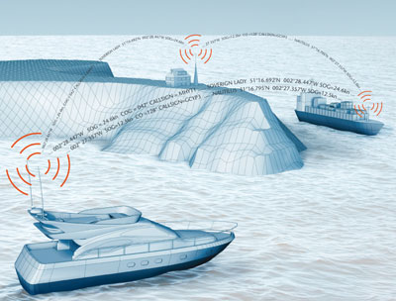
Existing Legislation on Spoofing
Although CFR and IMO regulations require AIS on certain ships, there is no specific penalty to those ships for transmitting false data
(Office of the Federal Register, 2012)
Notes:
SOLAS regulation V/19 - Carriage Requirements for Shipborne Navigational Systems and Equipment "requires AIS to be fitted aboard all ships of 300 gross tonnage and upwards engaged on international voyages, cargo ships of 500 gross tonnage and upwards not engaged on international voyages and all passenger ships irrespective of size. The requirement became effective for all ships by 31 December 2004."
CFR 33§ 164.46 Automatic Identification System.

Slide 6
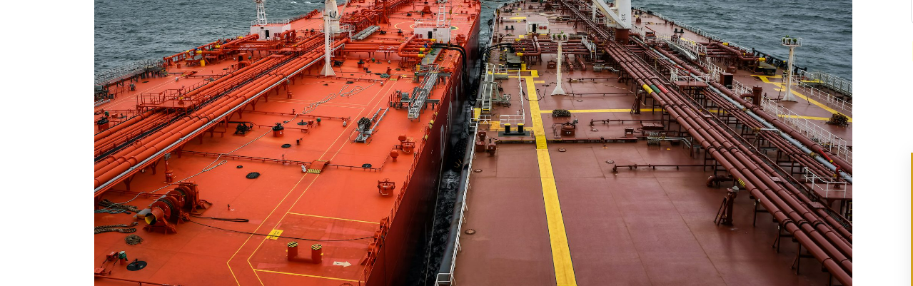
Who Spoofs?
Illegal Fishing Operations
Smugglers
Hostile Regimes such as Russia, North Korea, & Iran
(Bateman, 2021)
(Krüger, 2019)
(Nightingale, 2023)
Notes:
And why? Entities looking to cover up their illicit operations
- Vessels engaging in IUUF (typically Chinese)
Indian or Russian tankers attempting to avoid sanctions for Russian oil.
Russian military attempting to misdirect their militaries movements, or the movements of other vessels to stir trouble.
North Korea attempting to avoid sanctions.

Slide 7
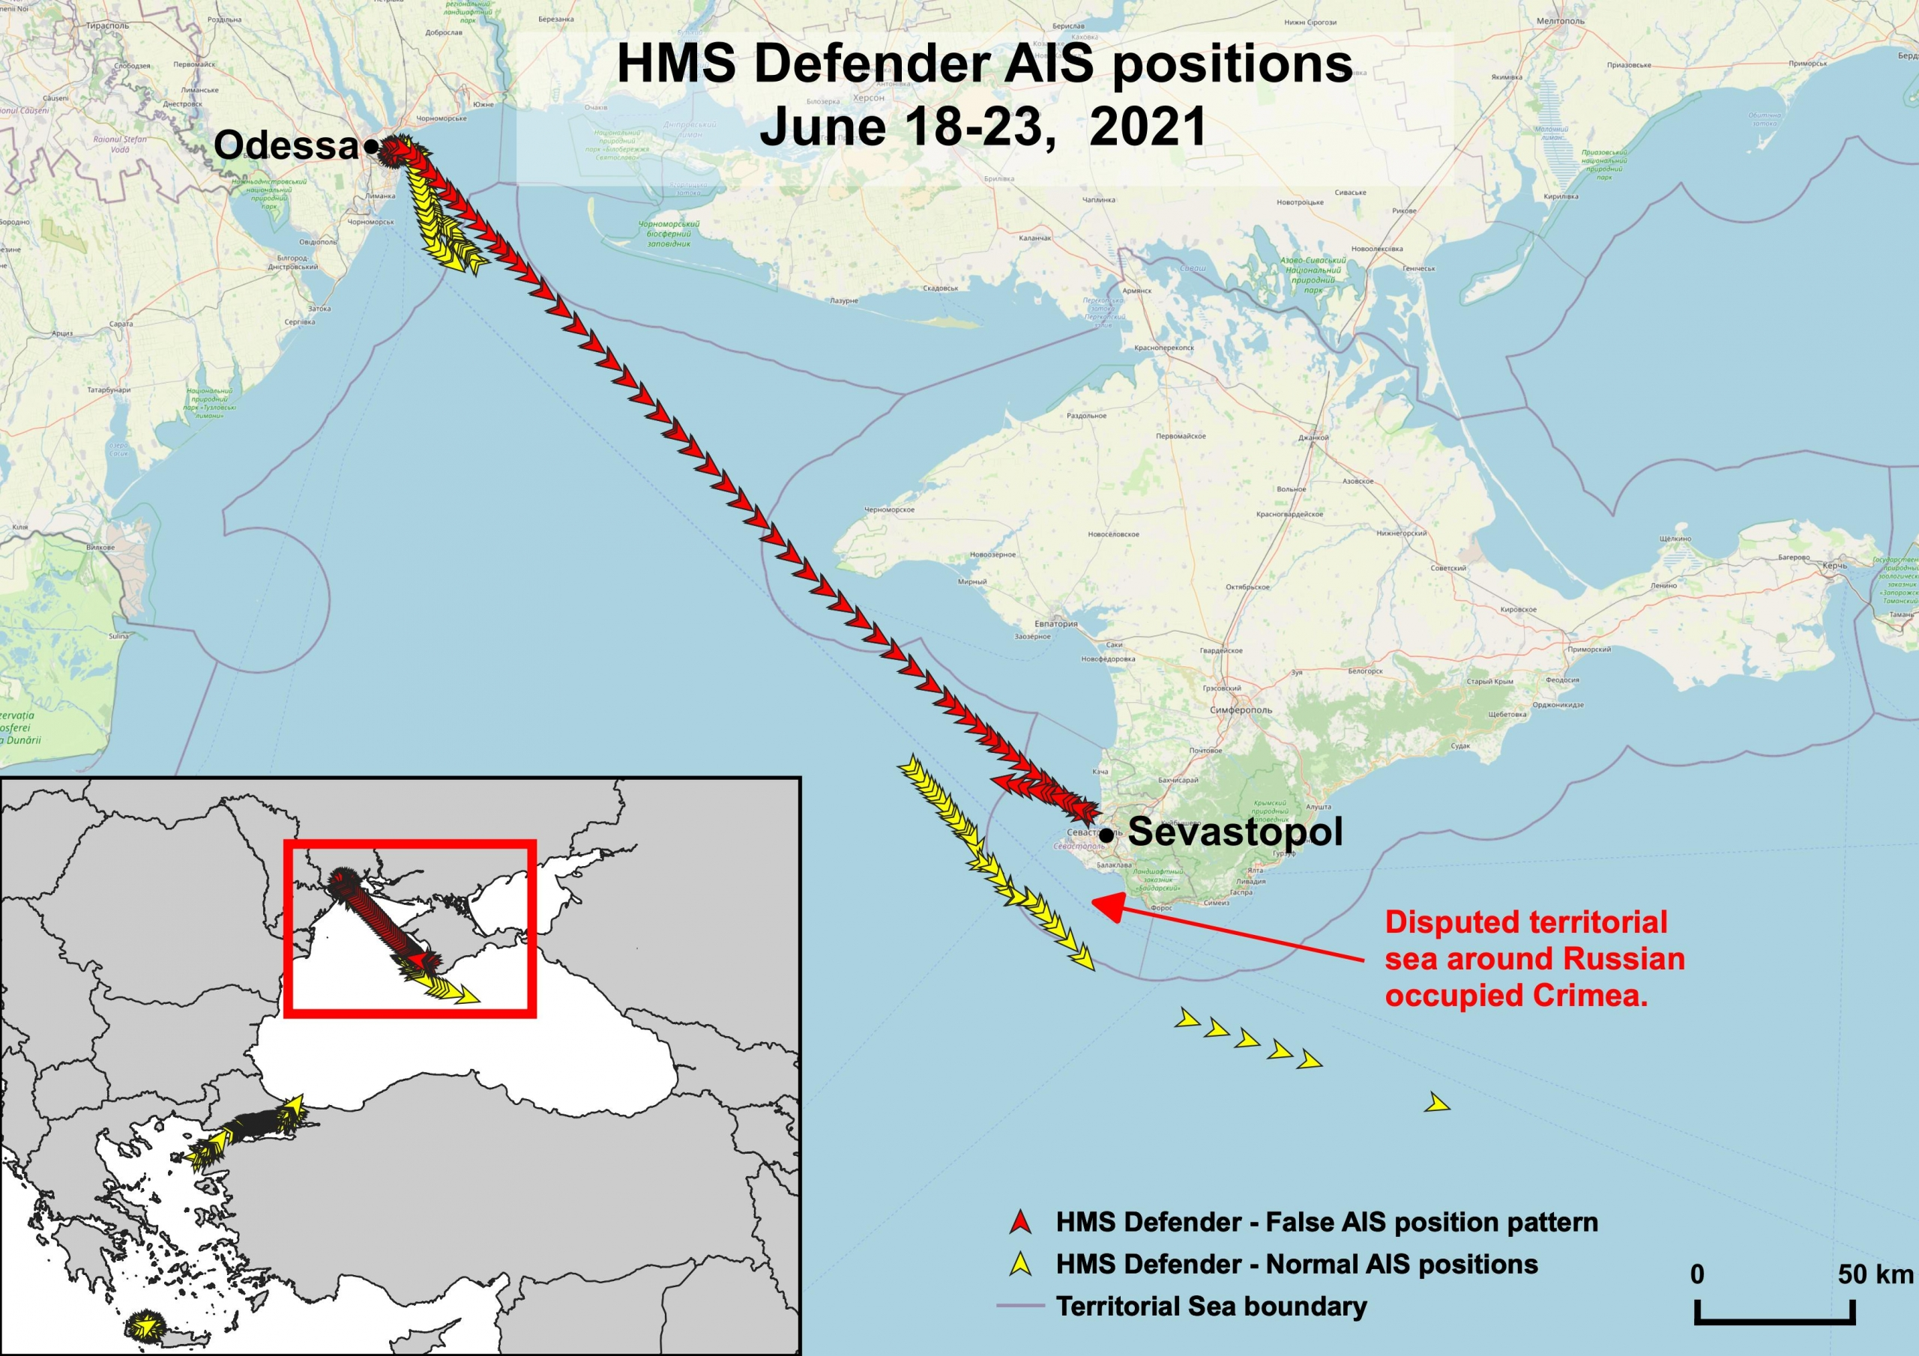
HMS Defender: The voyage that never happened.
(Bateman, 2021)
Notes:
On June 19th 2021, Marine Traffic data showed the HMS Defender approaching the port of Sevastopol in Crimea. However, camera live feeds showed the ship was 300 km away in Odessa, Ukraine (Bateman).
Suspected Russian involvement, as Russia proclaimed the voyage an act of agression and insinuated they fired warning shots at the vessel. Experts proclaim the incident as an accept by the Russian's to "display disruptive power" (Bateman).

Slide 8
Solution 1: Using RADAR, Satellites & Base Stations
Overview
Pros:
Cons:
Resource Burden
Latency in Acquisition time
inconclusive connections
Don’t have to push software out on the fleet, uses existing technology.
AIS Satellites and RADARs can use doppler shifts to determine the true position of an AIS transmitter
(Katsilieris et al., 2013; Kelly, 2022; Krüger, 2019)
Notes:
- Requires additional resources for law enforcement to man RADAR and Satellite stations to check the validity of AIS data.
: By analyzing Doppler frequency measurements from an AIS signal sensor satellite, a double-napped cone centered on the satellite is created, where the theoretical Doppler frequency matches the measured frequency based on the radial velocity to the AIS emitter. These matches form curves on the Earth's surface, allowing for the estimation of the AIS emitter's position.
“RADARSAT imagery data acquisition time and AIS data acquisition time may be different, the target vessel may move away from one position to another during the period of two different data acquisition times; therefore, the association between imagery and AIS data may not be very conclusive.” (Guo, 2014, p. 1).

Slide 9
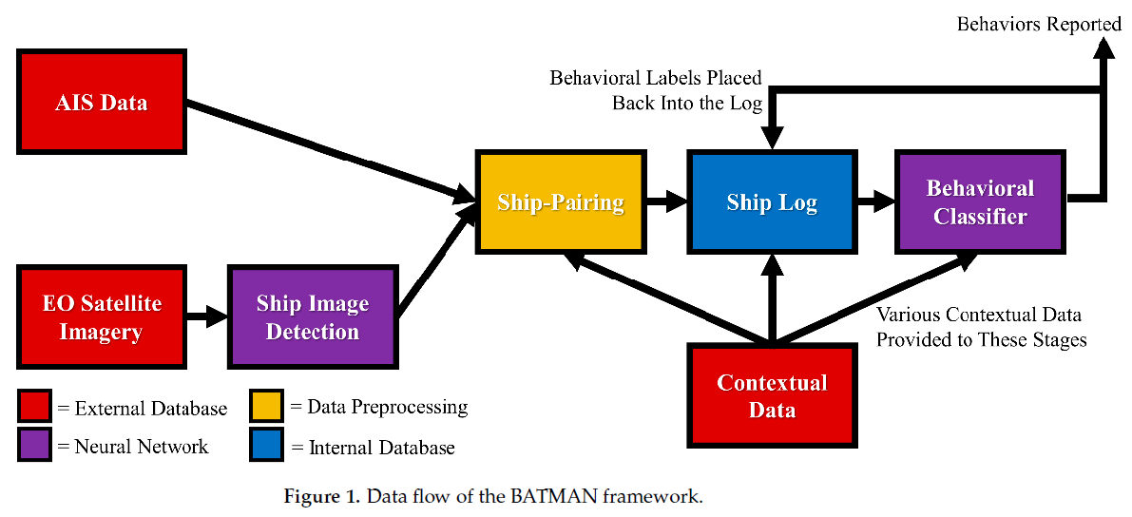
Solution 2: BATMAN
"A Brain-like Approach for Tracking Maritime Activity and Nuance"
Overview: The application combines visual spectrum satellite imagery with AIS data to identify and analyze maritime traffic.
Pro: Using computing power to detect suspicious activity requires no additional equipment, and programming is cool.
Con: AI Partnership with Law Enforcement may lead to violent overreaches in the event of false positives.
(Duan et al., 2023; Jones et al., 2023)
Notes:
By integrating contextual information such as exclusive economic zone boundaries, pipeline locations, and weather data, the pipeline aims to classify ships' behaviors, including illegal fishing and trans-shipment, using freely accessible sources like Google Earth. This approach seeks to enhance analysts' ability to identify and understand maritime activities.

Slide 10
Solution 3: Public Key System
Overview:
Pros:
Cons:
Difficult to establish trust, must choose between Certificate Authority or Web of Trust method.
"using public key cryptography to prevent spoofing whilst retaining backwards compatibility" (Wimpenny et al., 2022, p .335).
Signed Messages are authentic and backwards compatible
More reliable than bearing based detection
VHF Bandwidth problems
Slow roll out
(Goudosis & Katsikas, 2020; Goudossis & Katsikas, 2019; Kessler, 2020; Wimpenny et al., 2022)
Notes:
Pro “Using PKC to ‘digitally sign’ messages, as capable of providing unequivocal evidence that all AIS message types originate from genuine sources and so can be trusted.” (Wimpenny et al., 2022, p .335). “direction-finding techniques can only confirm a signal is on a correct bearing.” (Wimpenny et al., 2022, p .335).
“AIS lacks sufficient bandwidth to routinely authenticate all messages.” (Wimpenny et al., 2022, p .335).
“Phasing in the proposed solution is likely to be a slow process, both politically and technically.” (Wimpenny et al., 2022, p .335).

Slide 11

Recommended Solution: Combination of All Three
Take elements from all three. This is most costly, but most effective.
Public Key strategy means that you can be very sure that the AIS message you receive is unaltered and from the correct person, but people can still force the AIS to transmit bad data.
Using AI to detect the classic patterns of spoofed AIS information can detect when someone could be lying.
RADARSAT and Low Power detection to catch dishonest vessels red handed by determining their true geographic position.
Of course, no solution will work unless the Coast Guards of the world commit to stopping vessels, arresting smugglers, and fining owners for deliberately transmitting false AIS data.

Slide 12

Possible Negatives from our Favorite Solution
Industry
Upgrading the computers in the AIS transponders may cost a little extra money.
Environment
AISChain and the spoofing detecting AI “BATMAN” may require a lot of processing time and electricity, most if not all may be from non-renewable sources.
RADARSAT detection stations are not carbon neutral.
Society
Big Brother Spying on ships to make sure they are who they say they are, where they say they are, that they’re going where they say they’re going, and that when they get there, they will do what they said they’ll do is ethically tenuous.
Profession
The problem of establishing trust in the public key strategy opens a nest of problems relating to reliability and liability of Certificate Authorities or the peers in a web of trust. Could be a Flag-of-Convenience situation but in the tech space.
Use of AI based systems may make it harder for an honest vessel to be proven innocent if their true data happens to set off a flag in the program.

Slide 13
Positive Impacts from our Proposed Solution
Industry
More effective tracking of vessels with AIS without the spoofed data clouding the pool may mean additional transparency and safety in the waterways, leading to reduced insurance premiums.
Environment
Help to catch illegal fishing operations and dark-oil smuggling.
Society
Reduce likelihood of successful maritime cyber-terrorist attacks.
Profession
Knowing that you can trust your AIS data means that officers can be less paranoid about the screens matching reality and can more easily make collision avoidance decisions.

Slide 14
Conclusion
No matter how the world decides to tackle AIS Spoofing, our generation will be on watch when the change is implemented.
Understanding how to spot AIS spoofing, and what an anti-spoofing software update Entails
Be aware that GPS and AIS data may not always be reliable, so keep sharp on your navigation skills.
Notes:
(as far as what YOU have to do as the mate to ensure it’s working correctly, aka start thinking about how to explain it to the weathered old hulks). Our job as mates is to be info handlers, and we should act like it.
Take celestial fixes, check your contacts on the radar and visually, and call the captain if you are in doubt.

Slide 15
Discussion Questions
(1) What solution do you think is the best? Is there something obvious I didn’t think of?
(2) What should be the role of law enforcement in such a case? Can detection of probable spoofing be an actionable reason to get a warrant?
(3) What kinds of spoofing attacks might still get through the solution we picked?
(4) Can it be considered an act of war to launch an AIS based cyber attack like in the case of the Defender?
(5) Should the AIS legal requirement be expanded to include more vessels?

Slide 16
References
Bateman, T. (2021, June 28). HMS Defender: AIS spoofing is opening up a new front in the war on reality. Euronews. https://www.euronews.com/next/2021/06/28/hms-defender-ais-spoofing-is-opening-up-a-new-front-in-the-war-on-reality
Courtnell, J. (2023, February 10). What is spoofing? Your complete guide (+ 4 key AIS spoofing typologies). Pole Star. https://www.polestarglobal.com/resources/what-is-spoofing-your-complete-guide-4-key-
Duan, Y., Huang, J., Lei, J., Kong, L., Lv, Y., Lin, Z., Chen, G., & Khan, M. K. (2023). AISChain: Blockchain-based AIS data platform with dynamic bloom filter tree. IEEE Transactions on Intelligent Transportation Systems, 24(2), 2332–2343. https://doi.org/10.1109/TITS.2022.3188691
Goudosis, A., & Katsikas, S. (2020). Secure AIS with identity-based authentication and encryption. TransNav, International Journal on Marine Navigation and Safety Od Sea Transportation, 14(2), 287–298. https://doi.org/10.12716/1001.14.02.03
Goudosis, A., & Katsikas, S. (2020). Secure AIS with identity-based authentication and encryption. TransNav, International Journal on Marine Navigation and Safety Od Sea Transportation, 14(2), 287–298. https://doi.org/10.12716/1001.14.02.03
Jones, A., Koehler, S., Jerge, M., Graves, M., King, B., Dalrymple, R., Freese, C., & Von Albade, J. (2023). BATMAN: A brain-like approach for tracking maritime activity and nuance. Sensors (Basel, Switzerland), 23(5), 2424-. https://doi.org/10.3390/s23052424
Katsilieris, F., Braca, P., & Coraluppi, S. (2013). Detection of malicious AIS position spoofing by exploiting radar information. 1196– 1203. https://ieeexplore.ieee.org/document/6641132
Kelly, P. (2022). A novel technique to identify AIS transmissions from vessels which attempt to obscure their position by switching their AIS transponder from normal transmit power mode to low transmit power mode. Expert Systems with Applications, 202, 117205-. https://doi.org/10.1016/j.eswa.2022.117205

Slide 17
References Cont.
Office of the Federal Register. (2012). 33 CFR 164.46—Automatic Identification System (AIS). National Archives and Records Administration. https://www.ecfr.gov/current/title-33/part-164/section-164.46 ​
Krüger, M. (2019). Detection of AIS spoofing in fishery scenarios. 2019 22th International Conference on Information Fusion (FUSION), 1–7. https://doi.org/10.23919/FUSION43075.2019.9011328 ​
Nightingale, A. (2023, September 27). Tanker tricks on the high seas expose shadowy russian oiltrade [Newspaper]. Bloomberg Law. https://news.bloomberglaw.com/international-trade/tanker-tricks-on-the-high-seas-expose-shadowy-russian-oil-trade​
​Wimpenny, G., Šafář, J., Grant, A., & Bransby, M. (2022). Securing the automatic identification system (AIS): Using public key cryptography to prevent spoofing whilst retaining backwards compatibility. The Journal of Navigation, 75(2), 333–345. https://doi.org/10.1017/S0373463321000837

